Slide 1
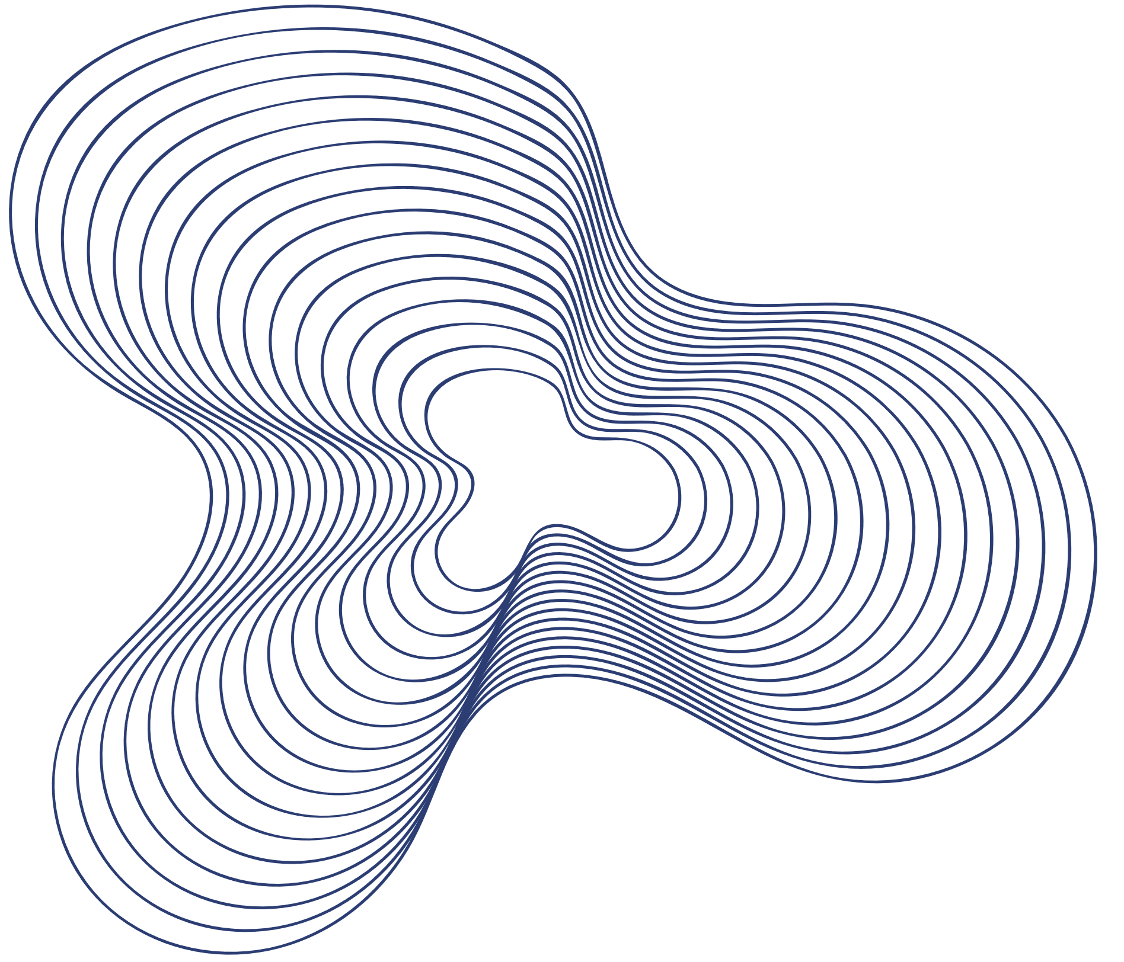

Dishari AI-Assisted Experiential Hiring Platform
Presented BY : IUBAT_Broken_Heart

Slide 2


Problems
Company doubts about the readiness of fresh graduates
Freshers face barriers to entering the workforce due to a lack of practical experience
Underemployment and Skill Underutilization
Gap of relative skillset
Less possibility the freshers to prove their capacity and the capability
IUBAT_Broken_Heart

Slide 3



SOLUTION 1
A platform where companies post real-world challenges instead of traditional job listings.
OUR SOLUTIONS
SOLUTION 2
SOLUTION 3
SOLUTION 4
Remove the Struggling phase of judging a candidate through a CV
Satisfactory medium for both sides.
Company get what they want
Reduced Applicant Grievances thorough LLM model (open source)

Slide 4
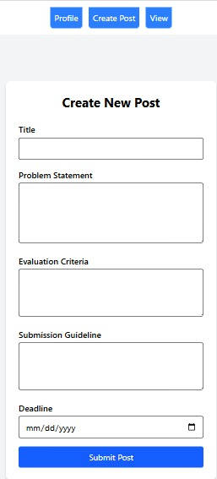
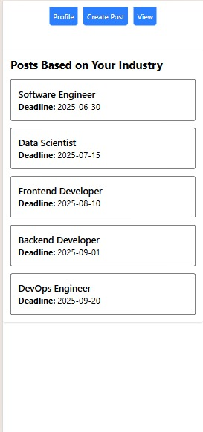
COMPANY VIEW

Slide 5
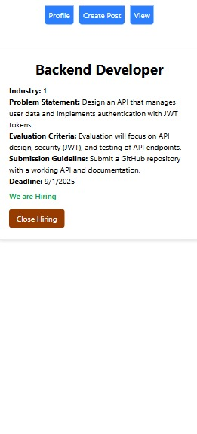
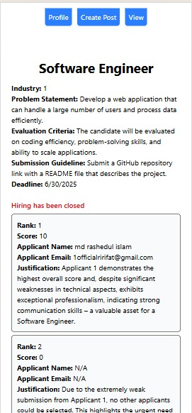

Slide 6
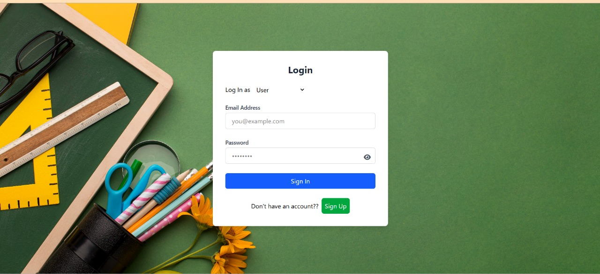
USER VIEW

Slide 7
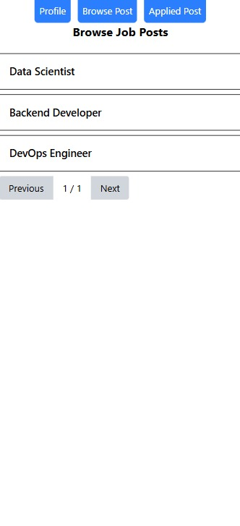
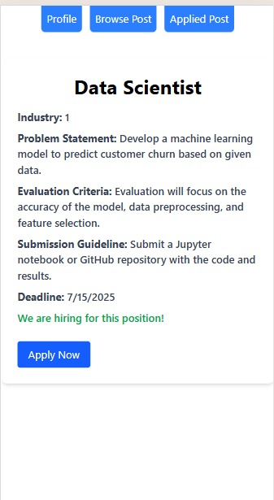

Slide 8
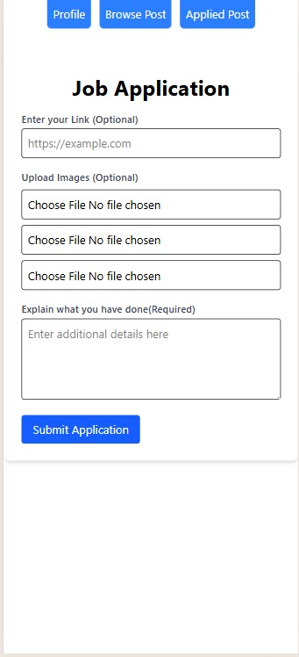
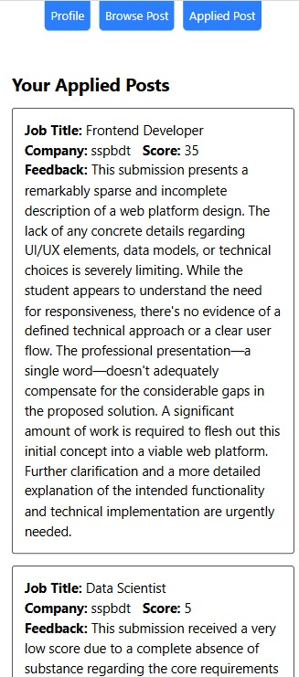

Slide 9
WHY USE LLM MODEL
Scalable Evaluation: Automates the initial evaluation of numerous project
submissions, a task that is impractical and time-consuming for manual review.
Future Scope to Checking AI integration by finetune process.
● Objective Initial Screening: Ensures consistent and unbiased initial evaluation,
preventing misjudgment and discouraging illicit activities in the screening phase.
● Adoption of State-of-the-Art Technology: Leverages current AI capabilities to
create an innovative and ecient hiring solution, aligning with technological
trends

Slide 10
AIM of OUR PROJECT
Encouraging companies to prioritize talent acquisition by focusing on potential
Bridge the Experience Gap for Fresh Graduates
efficiently shortlisting top candidates
Build a Sustainable Talent Ecosystem

Slide 11
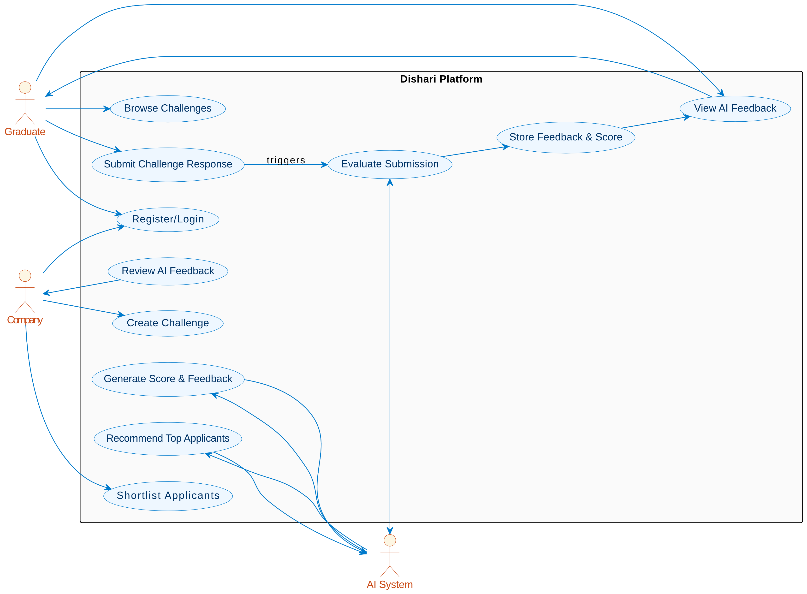
SYSTEM
DESIGN

Slide 12
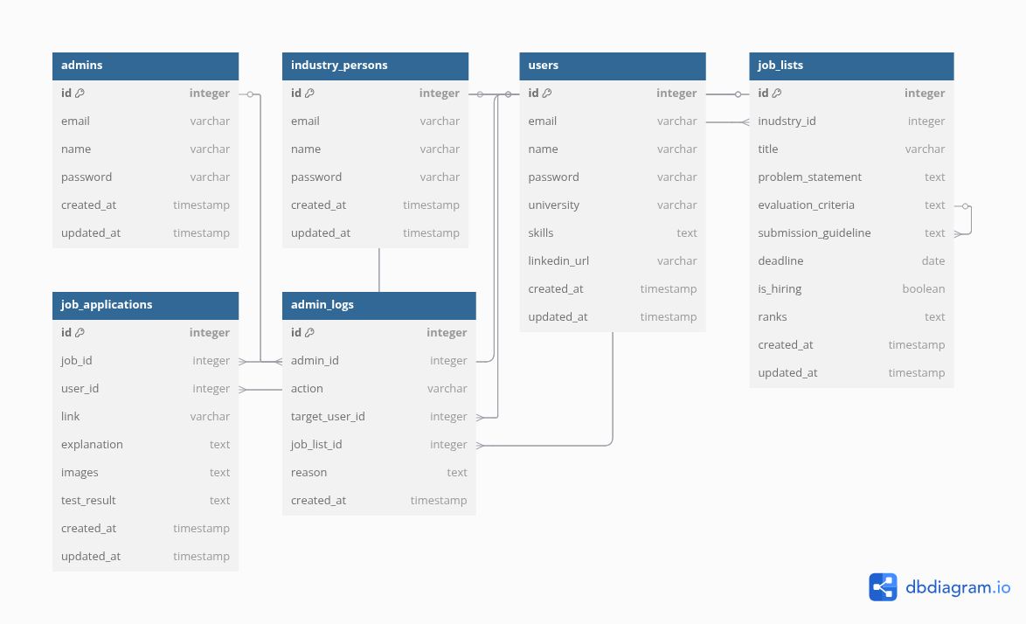

Slide 13

THANK YOU
Presented BY: IUBAT_Broken_Heart

